Slide 1
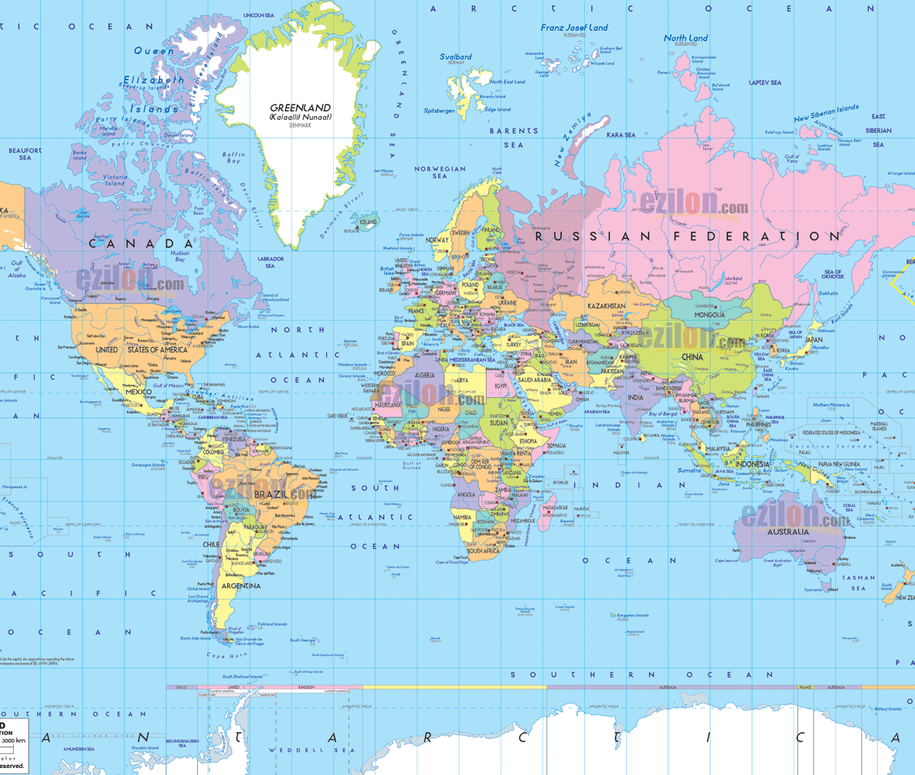
Analyzing Global Political Satisfaction: The Roles of Well-Being, Hardship, Trust, and Corruption Across Regime Types
Rob Heiber | Mohammad Sohel Mahmud
ADTA 5940 Analytics Capstone Experience
Dr. Denise Philpot | April 2026
Map source: ezilon.com

Slide 2
Research Problem
Political satisfaction is not explained by regime labels alone.
Citizens also respond to performance, trust, and transparency.
Regime context may change the strength of these effects.
Regime context can amplify or weaken the relationship
Well-being
Trust
Regime type
Political Satisfaction
Hardship
Corruption

Slide 3
Literature and Hypotheses
Well-being influences political judgment.
01
Economic hardship can reduce satisfaction.
02
Corruption weakens institutional confidence.
03
Transparency may strengthen trust and legitimacy.
04
H1: Higher perceived corruption and greater hardship reduce trust and political satisfaction.
H2: Trust’s effect on political satisfaction depends on regime type and transparency.
Notes:
Summarize the literature in 30 to 45 seconds.
Keep the focus on the logic of the hypotheses.
Mention that prior research suggests performance matters more than labels alone.

Slide 4

Data and Measures
WVS Wave 7 (2017–2023) is a global survey of values, beliefs, and social norms conducted in 64 countries with over 80,000 respondents.
Group | Variables | Role
Outcome | Political satisfaction (Q252_DV) | Dependent variable
Main predictors | Well-being, institutional trust, hardship, corruption transparency, polity/regime context | Core explanatory variables
Controls | Sex, age, education, social class, income | Background covariates
Notes:
Explain the sample size and why it gives strong statistical power.
Briefly mention reverse-coding and centering.
Note that HC3 robust standard errors were used.

Slide 5
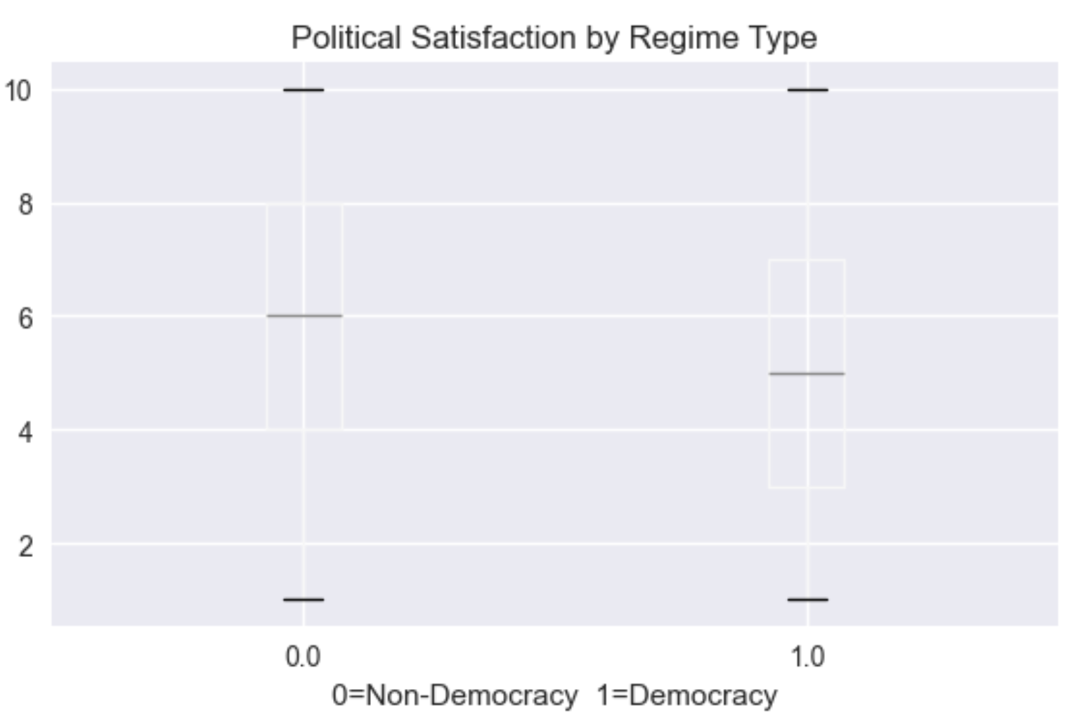
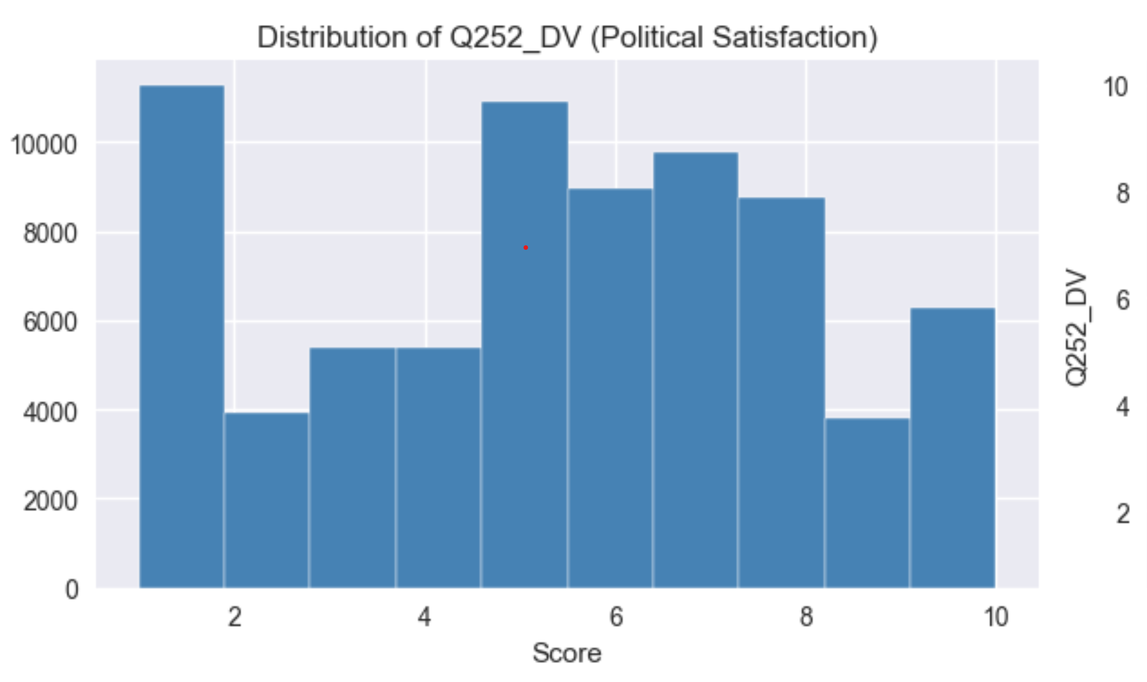
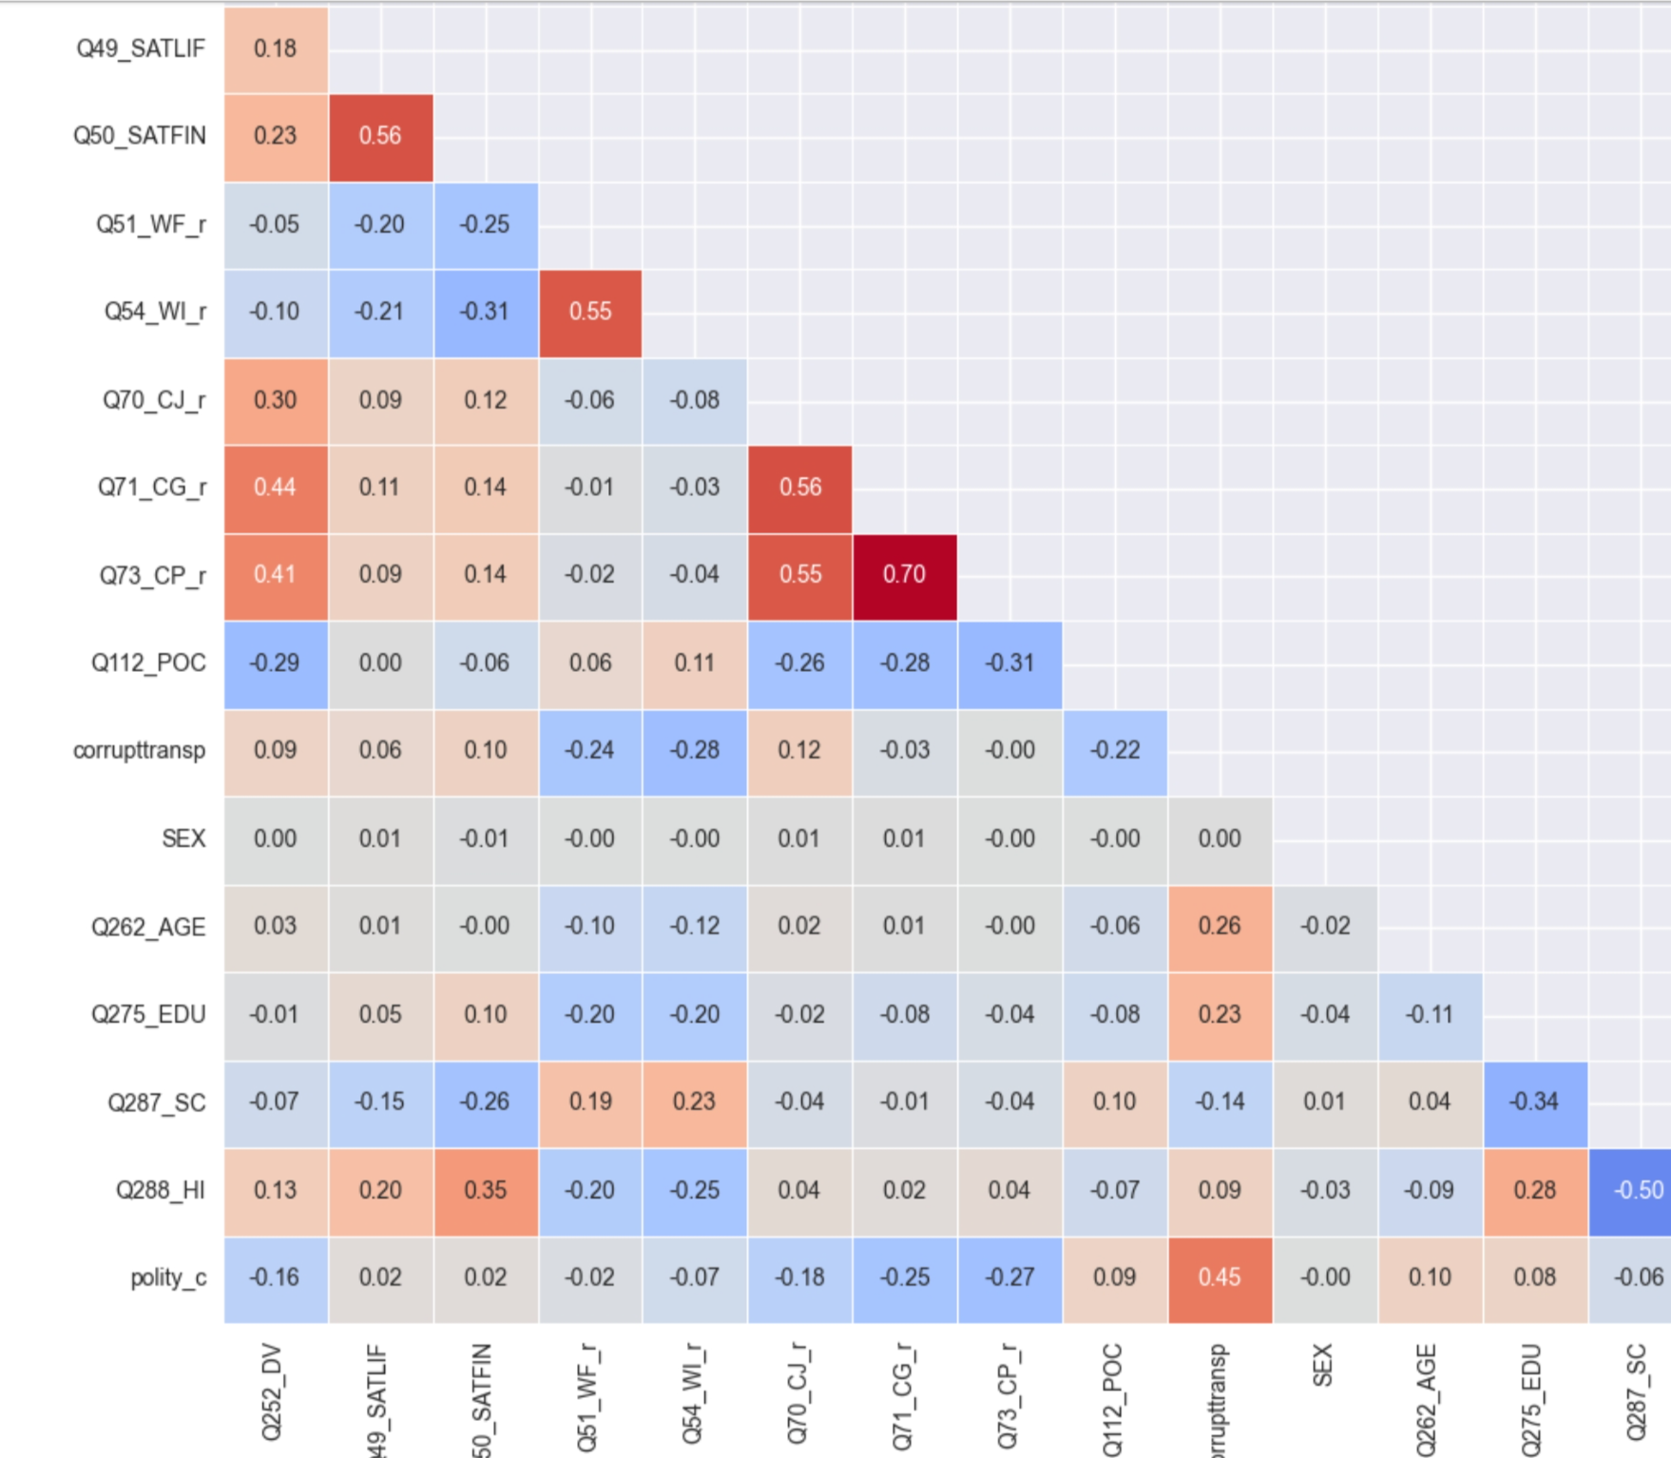
Exploratory Data Analysis
Box plot
Political satisfaction is distributed across the full 1-10 scale, with most responses concentrated in the middle and upper-middle range.
The outcome differs somewhat by regime type.
Trust and well-being are positively associated with satisfaction.
Hardship and cynicism show weaker or negative associations.
Corruption transparency has a notable relationship with satisfaction.
Correlation heat map

Slide 6

Model Strategy
We built the models in a nested sequence so we could test how each added block of variables improves fit.
Model 1: controls only.
Model 2: individual-level predictors.
Model 3: adds polity.
Model 4: adds corruption transparency.
Model 5: binary democracy split.
Preferred model: Model 4.
Model | Predictors Added | Adj. R² | N | Adj. R² Gain
M1 | Controls only | 0.020 | 71,866 | -
M2 | Individual predictors | 0.277 | 69,303 | 0.257
M3 | + Polity score | 0.279 | 69,303 | 0.002
M4 | + Corruption transparency | 0.285 | 69,303 | 0.006
M5 | + Democracy binary | 0.283 | 69,303 | -0.002

Slide 7
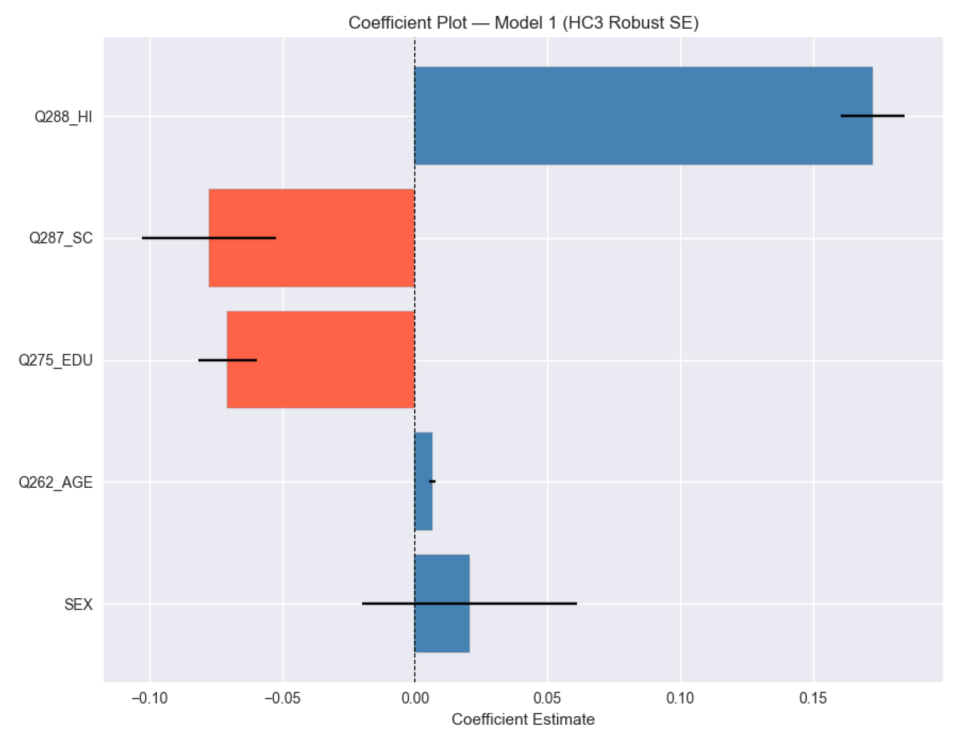
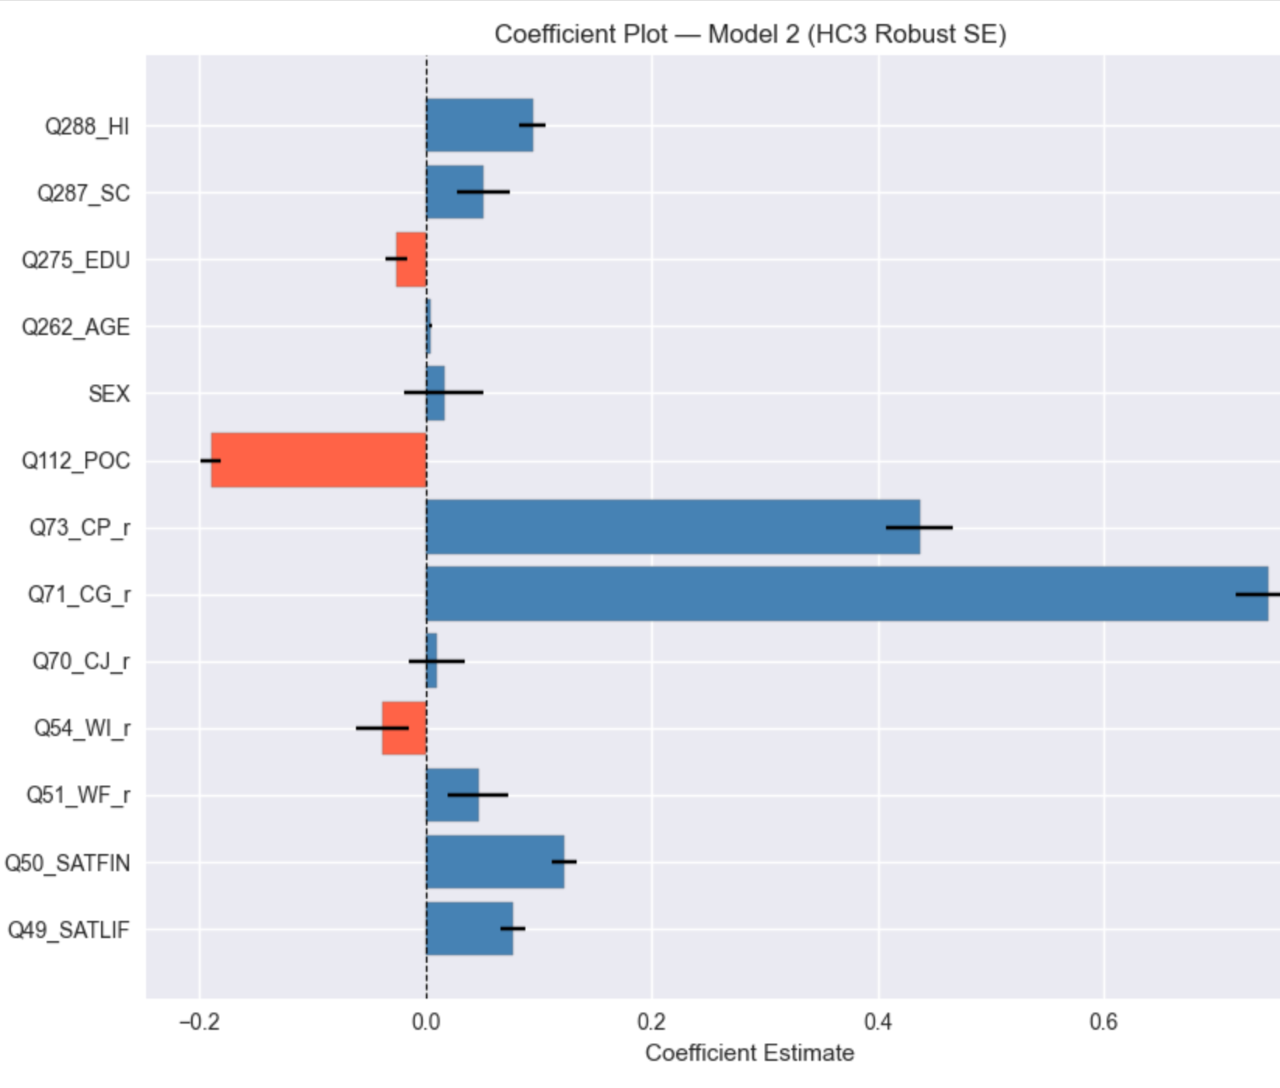
Model 1 & 2 Results
Model 1: limited explanatory power.
It shows that the household income (Q288) is the strongest positive predictor.
Model 2: major improvement in fit.
It shifts the explanation away from a demographic story towards trust and well-being and trust variables dominate followed by life and financial satisfaction.
Model 1 is mostly a baseline check, while Model 2 shows that institutional trust and subjective well-being are the main drivers of the dependent variable.

Slide 8
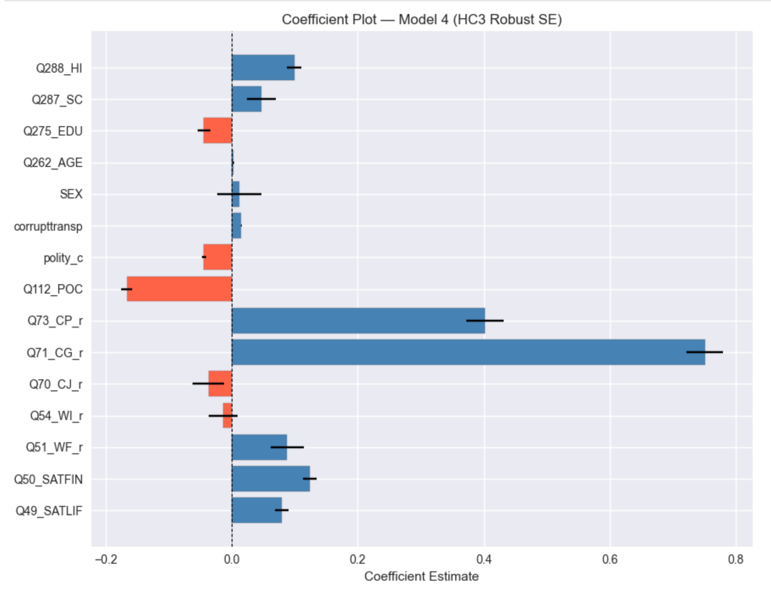
Model 4 results
Polity_c is negative and significant, as democracy/Polity increases, satisfaction does not automatically rise, indicates that citizens in more democratic settings can be more demanding and more evaluative of government performance.
Transparency is positively related to satisfaction, meaning more transparent contexts are associated with higher political-system satisfaction in this model.
More democratic settings seem to encourage more critical citizen evaluations, while transparency helps build satisfaction; importantly, trust has a context-dependent effect rather than a one-size-fits-all effect.
Model 4 adj. R² = 0.285 (in the final model comparison)

Slide 9
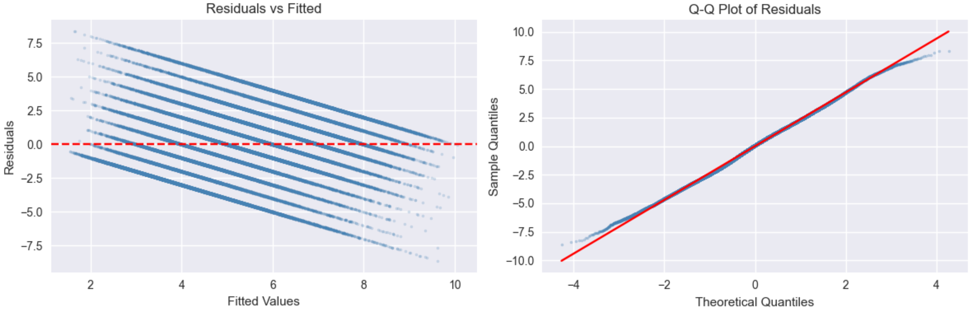
Diagnostics and Subgroup Patterns-acceptance tests
Residuals vs. Fitted values show banding consistent with the bounded 1-10 outcome scale;
The Q-Q plot is approximately linear with modest tail departures, so the residuals are mostly normal with a little deviations at the ends.
So, the model is broadly acceptable and the HC3 robust standard errors help protect inference. our inference remains reliable even with modest non-normality or heteroskedasticity.

Slide 10



Conclusion and Recommendations
Political satisfaction depends on performance, trust, and transparency. Trust builds legitimacy.
Anti-corruption and accountability are key policy levers. Accountability reduces corruption risk.
Democracies can create higher expectations, not always higher satisfaction.

Slide 11
Appendix

